Slide 1

PET PARADISE SYSTEM
A.Thivyan
ASP/18/19/109
COM1302

Slide 2
NEED OF DBMS
In a pet shop, manual maintaining of spread data is much complicated and hard.
Customers want to access data simultaneously through different applications.
Therefore, we want to simplify these work loads by constructing an unique database.
And also, managers, suppliers and sales executives can make reports from the sales and stocks accurate details.
REQUIREMENT GATHERING
When I dealing with our suppliers, customers and stock keepers, I felt that they needed a way to work efficiently.
So, I make some polls for feedbacks of each and everyone by some forms.
And arranged a board meeting with senior staffs and customers.
Observing their every day routine work pressures.

Slide 3
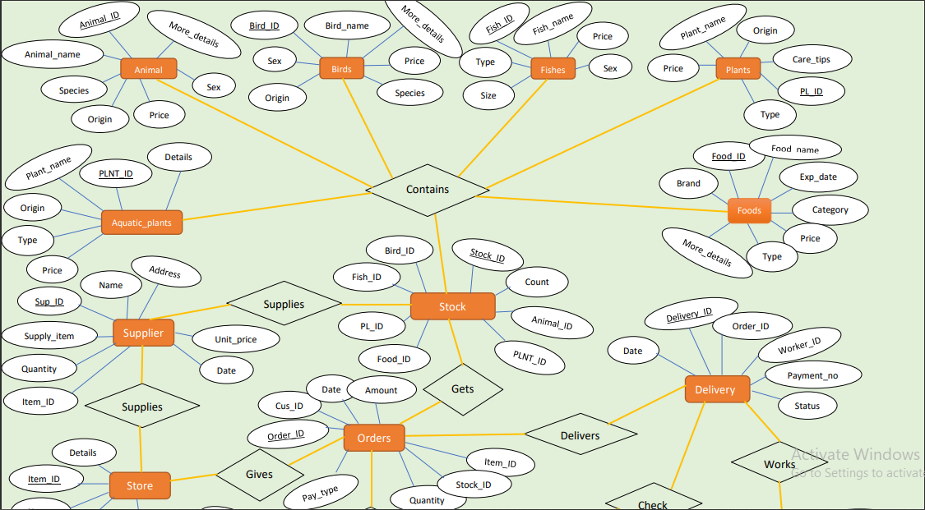
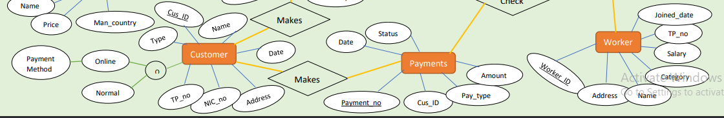
CASE STUDY
In this paradise, there are many blocks such as ANIMALS, BIRDS, FISHES, FOODS, PLANTS, AQUATIC PLANTS, STOCKS and STORE.
Available items will be stored in STOCKS. Stock manager and suppliers will see the information and get conclusion about it.
Customers will give their information to system and do purchases.
Pets and accessories are bought from SUPPLIERS and some CUSTOMERS (There are several suppliers and for the shop). I store each supplier details under Company or Individual name, Supplier ID, Contact Number and Address.
There are huge amount of CUSTOMER base in this shop. These customers are register under Name, NIC, Customer ID and Date of purchase of Item or Service.
Customer ID will be provide when they make purchases.
After completing payments, items will be provide for customers and Stock details will be update.
ER- Diagram

Slide 4
Relational Schema
Blocks
BL_no | BL_name | Location | Facilities | Available_items
Animals
Animal_ID | Animal_name | Species | Origin | Sex | Price | More_Details
Birds
Bird_ID | Bird_name | Price | Origin | Sex | Species | More_Details
Fishes
Fish_ID | Fish_name | Size | Sex | Type | Origin | Price
Plants
PL_ID | PL_name | Price | Type | Origin | Care_tips
Aquatic_plants
PLNT_ID | PL_name | Origin | Type | Details | Price
Foods
Food_ID | Food_name | Exp_date | Price | Category | Type | Brand | More_Details
Stock
Stock_ID | Animal_ID | Bird_ID | Fish_ID | PL_ID | PLNT_ID | Food_ID | Count | Sup_ID
Store
Item_ID | Item_name | Price | Man_country | Details
Customers
Cus_ID | Cus_name | Date | NIC_no | Address | TP_no | Type
Workers
Worker_ID | Name | Category | Address | Salary | TP_no | Joined_date
Supplies
Sup_ID | Name | Address | Supply_Item | Quantity | Unit_price | Supply_date | Item_ID
Orders
Order_ID | Cus_ID | Pay_type | Item_ID | Quantity | Date | Amount | Stock_ID
Payments
Payment_no | Cus_ID | Pay_Type | Amount | Date | Status
Delivery
Delivery_ID | Worker_ID | Order_ID | Payment_no | Date | Status

Slide 5
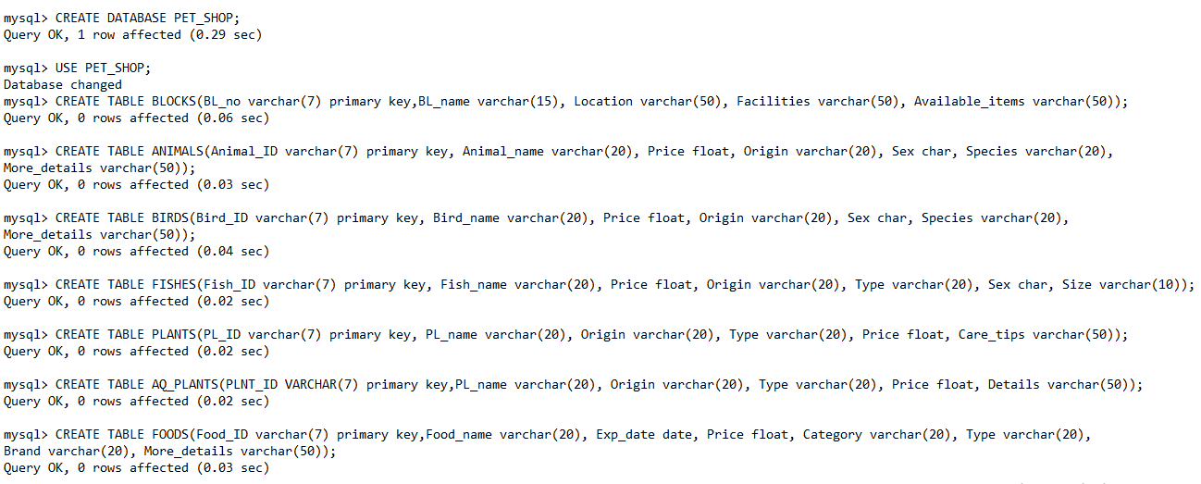
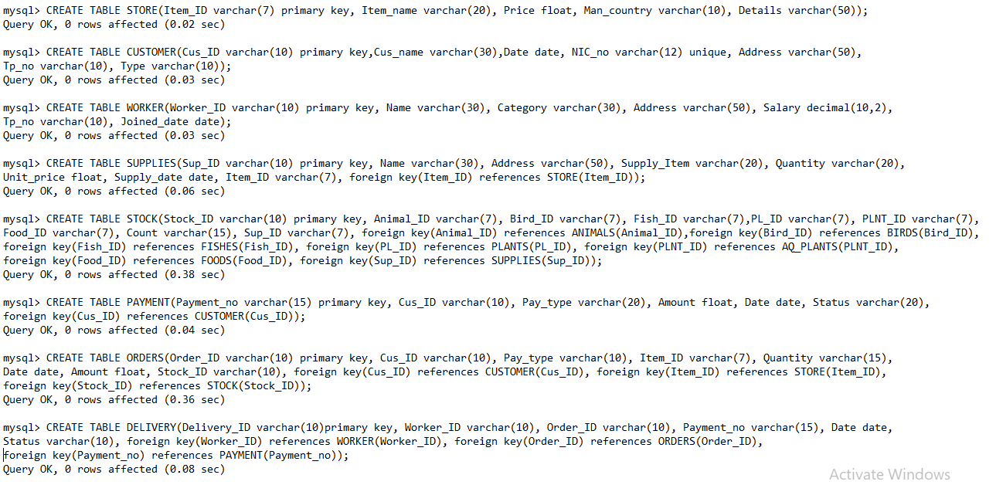
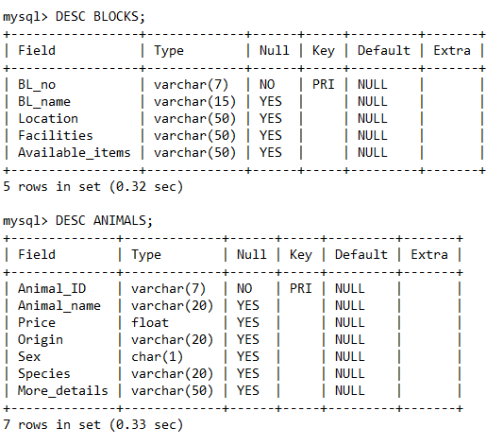

Slide 6
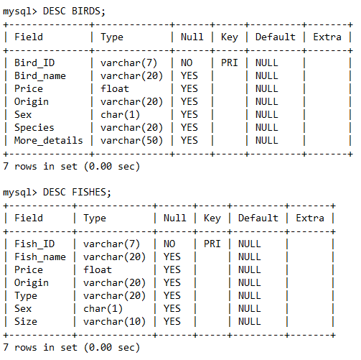
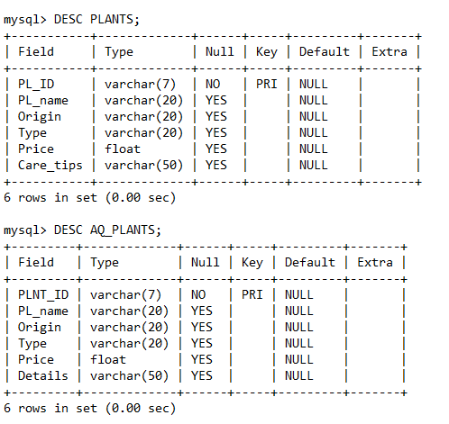

Slide 7
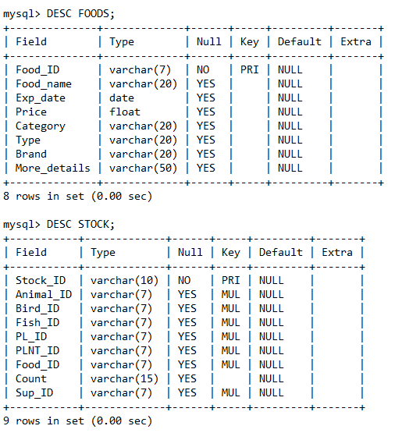
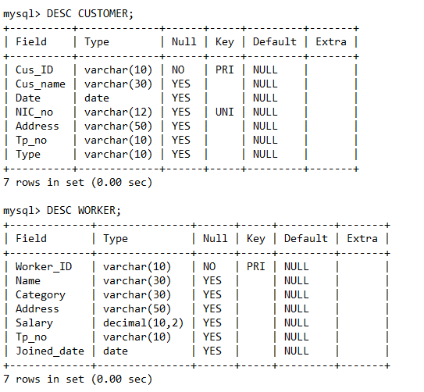

Slide 8
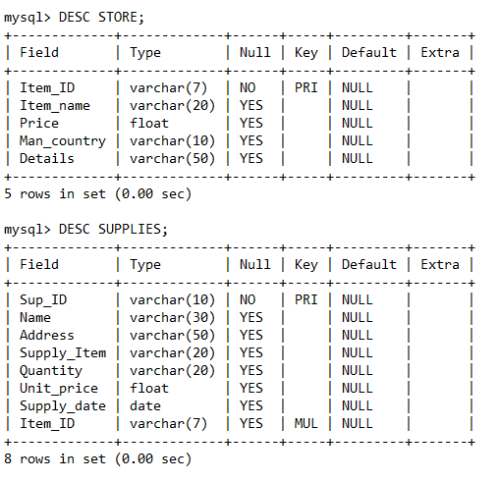
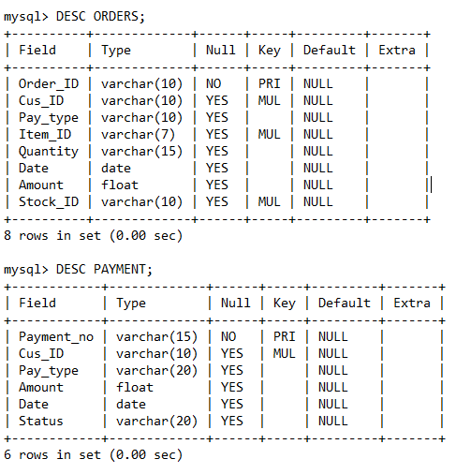

Slide 9
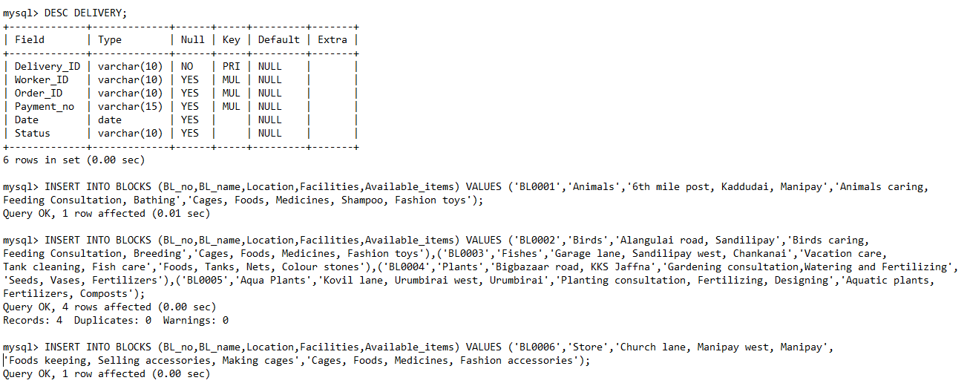
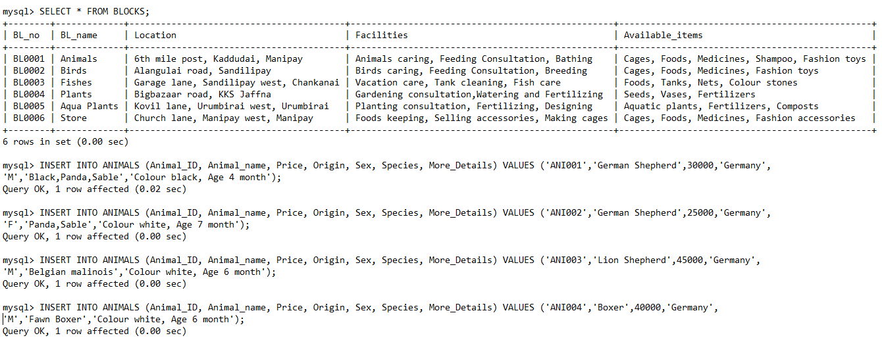
Thank you

